Slide 1

Transfer Learning for LLM
Dr. Rakhee Chhibber

Slide 2
Agenda
Transfer Learning for LLMs
How it is done ?
What are the two approaches to transfer learning
Features extraction approach and
Fine tuning approach, how is each type of fine tuning different from the other

Slide 3
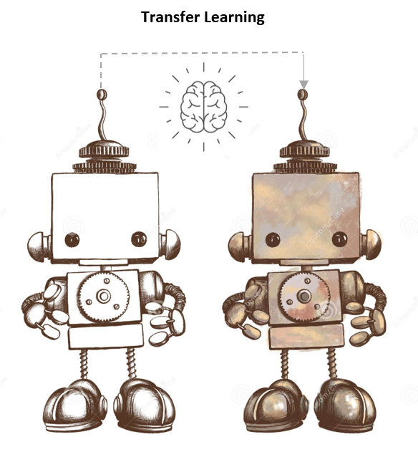

Slide 4
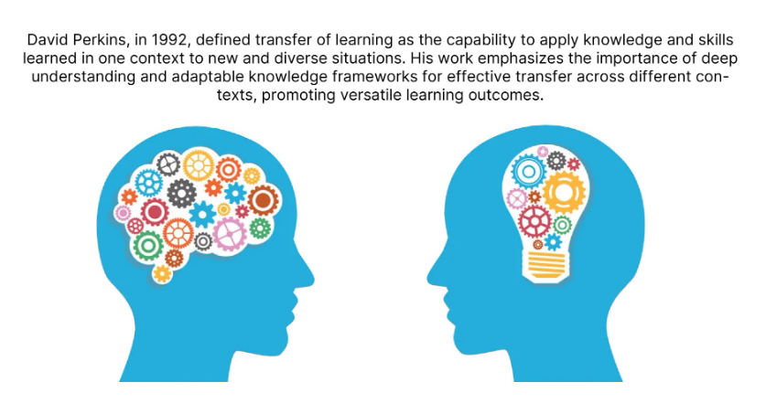

Slide 5
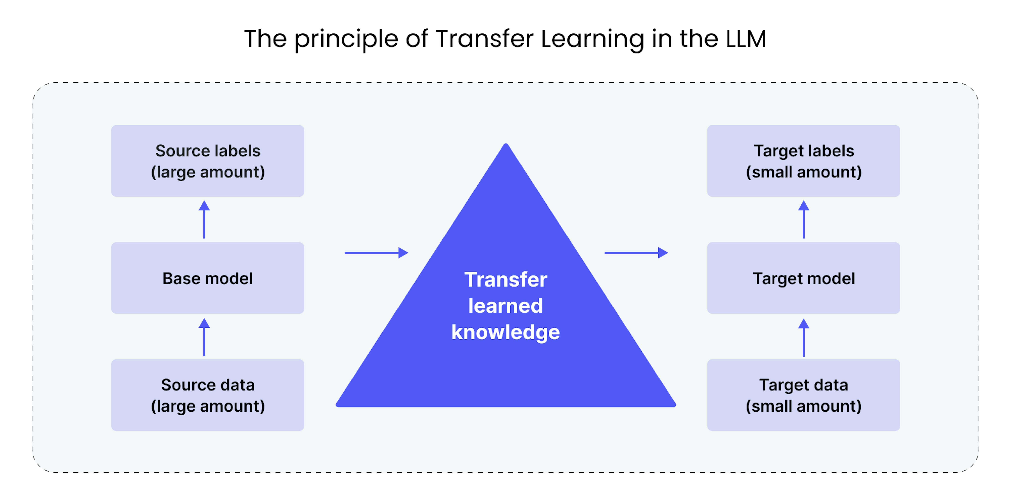

Slide 6
Introduction
Recently, deep learning models have allowed to get significant improvements in performances of machine learning models, representing a solution to the problems of traditional machine learning algorithms. Nevertheless, training of models from scratch does not always represent a good solution, as it is difficult but also expensive to have a dataset of sufficient size available to obtain a satisfactory prediction result for a specific task. What if we do not have such amount of data? A solution is Transfer Learning, which consists in pre-training a network on very large public datasets with a large number of classes. It allows you to use features calculated by the pre-trained network in order to use them to solve the issue at hand.

Slide 7
Transfer learning techniques
There are two different :
Fine tuning and
Feature extraction.
Both techniques are used to leverage knowledge from a pre-trained model on a very large source task to improve performance on a target task. Why does Transfer Learning work? Motivated by the insight that the earlier features of a model comprise more generic features that could be beneficial across numerous tasks (e.g. edge detectors or color blob detectors in case of image classification tasks), later layers of the model represent instead more specific details of the classes contained in the original dataset.

Slide 8
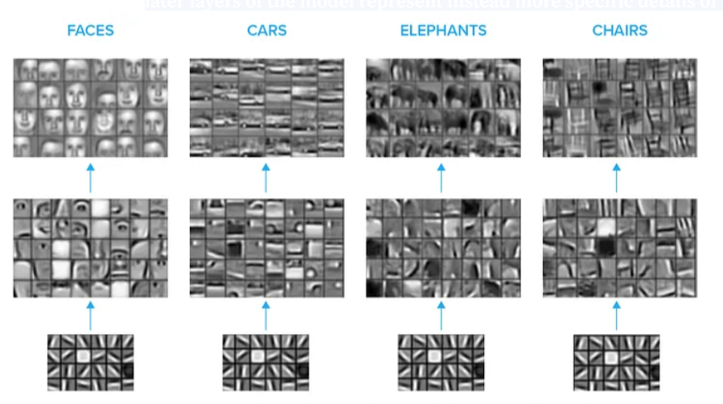
In the picture, we can see different specific tasks of image classification: face detection, car, elephants and chairs. They have generic feature in common, embedded in the earlier layers. Later layers are, instead, different from each others: for example, for face detection task we could have features about nose, eyes and so on

Slide 9
Feature Extraction
It uses the representations learned by the pre-trained network to extract meaningful features for new samples of a specific task. At this point, you can simply add a new classifier, which will be trained from scratch but on top the pre-trained model, so that you can reuse the feature map learned previously. Specifically, the pre-trained model’s parameters are kept frozen during training on the target task. This way you do not need to retrain the whole (more complex) model because the base network already contains features that are generally useful for different specific tasks.

Slide 10
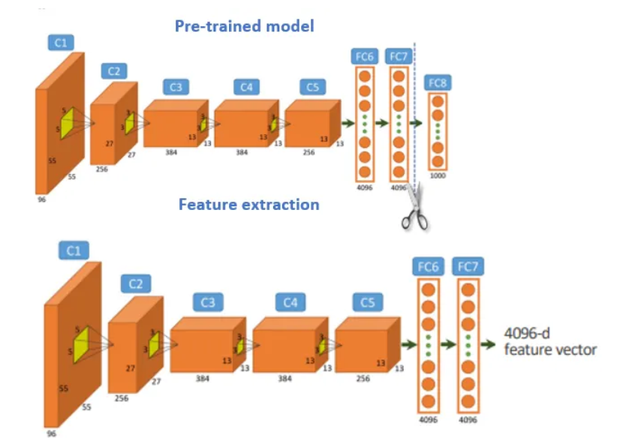
Feature extraction of a pre-trained convolutional network that has the image classification of 1000 classes as source task. The result of the extraction is a 4096-d feature vector

Slide 11
Feature extraction is particularly useful when the target task has a small dataset or when computational resources are limited.
If the target task dataset is similar to the source task dataset you should perform a training on the pre-trained model features from higher layers (detailed features).
Otherwise, if the dataset is very different from the original dataset, then you should perform a training on the features extracted from lower layers (general features).
A possible limit is overfitting, which can occurs if the amount of new data is particularly limited. On the other side, it is computationally less expensive than fine tuning as it requires training only for the added layers, which generally have fewer parameters than the pre-trained layers.

Slide 12
Core Workflow for feature extraction
Load a Pre-trained Model: Select a base model like BERT or RoBERTa.
Freeze Weights: Ensure the base model's parameters remain unchanged during training.
Extract Embeddings: Feed text through the frozen model to obtain high-dimensional feature vectors.
Train a Classifier: Pass these vectors into a small, new head (e.g., Logistic Regression or a shallow Neural Network) to perform the final task.

Slide 13
When to Use Feature Extraction?
Small Datasets: Useful when you have very little labeled data, preventing overfitting.
Limited Hardware: Computationally cheaper than full fine-tuning because you only train the small classifier head.
Speed: Ideal for rapid prototyping or situations where you need to pre-compute embeddings for faster inference

Slide 14
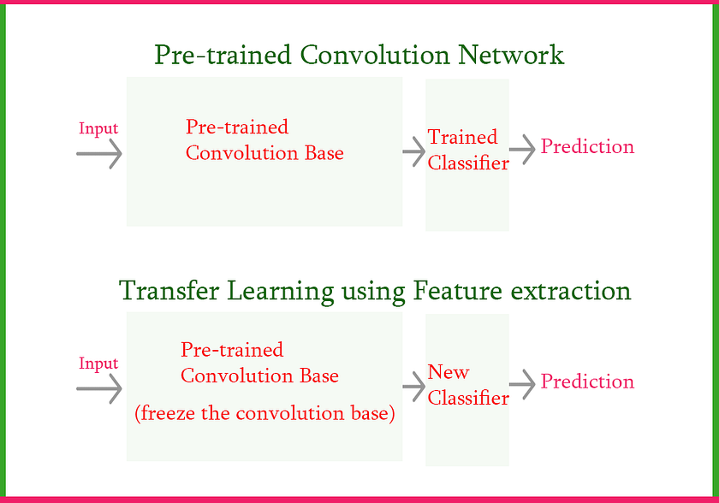

Slide 15
Approach #1: Feature Extraction
The Concept - treat the pretrained model (like VGG16, ResNet, or Inception) as an automatic feature extractor. You freeze all the model’s layers and take the features it produces as input for simple additional layers — like Dense Layers or even Logistic Regression — to perform your final classification.
When to Use It? - When you have limited data, When your data is similar to the original dataset the model was trained on (e.g., general images), When you need a quick and effective solution
Advantages
Lightning fast training — doesn’t require a powerful GPU or long training time
Ideal for small datasets — minimal risk of overfitting
Easy to implement — simple and straightforward code
Disadvantages
Limited performance if your new data is significantly different from the original (e.g., medical images, X-rays, industrial imagery)
The model doesn’t adapt to your project’s specifics

Slide 16
Code for Transfer learning
Transfer learning using feature extraction 1 – rakheechhibber1971@gmail.com
Transer Learning feature extraction 2.ipynb
Transfer learning using feature extraction.ipynb
Step wise Transfer learning by fine tuning.ipynb

Slide 17
import numpy as np import tensorflow as tf from tensorflow.keras.applications import VGG16 from tensorflow.keras.datasets import cifar10 from tensorflow.keras.utils import to_categorical from tensorflow.keras.models import Sequential from tensorflow.keras.layers import Dense, Flatten # Load CIFAR-10 dataset (train_images, train_labels), (test_images, test_labels) = cifar10.load_data() # Normalize pixel values to be between 0 and 1 train_images, test_images = train_images / 255.0, test_images / 255.0

Slide 18
# One-hot encode the labels train_labels = to_categorical(train_labels, num_classes=10) test_labels = to_categorical(test_labels, num_classes=10) # Load pre-trained VGG16 model without the top (classification) layer base_model = VGG16(weights='imagenet', include_top=False, input_shape=(32, 32, 3)) # Freeze the weights of the pre-trained layers for layer in base_model.layers: layer.trainable = False )

Slide 19
# Create a new model on top of the pre-trained base model model = Sequential([ base_model, Flatten(), Dense(256, activation='relu'), Dense(10, activation='softmax') # Output layer with 10 classes ]) # Compile the model model.compile(optimizer='adam', loss='categorical_crossentropy', metrics=['accuracy'])

Slide 20
# Train the model history = model.fit(train_images, train_labels, epochs=10, batch_size=64, validation_data=(test_images, test_labels)) # Evaluate the model test_loss, test_acc = model.evaluate(test_images, test_labels) print("Test Accuracy:", test_acc

Slide 21
Exercise
Practice Problem: Identify the Apparels: Identify the type of apparel for given images
Practice Problem: Identify the Digits: Identify the digit in given images

Slide 22
Approach #2: Fine-tuning
The Concept - not just using the pretrained model — you’re also continuing its training on your specific data! You unfreeze some layers (typically the last ones) and retrain them with a small learning rate, allowing the model to learn the fine details unique to your project’s data.
When to Use It?
When you have sufficient data (at least thousands of images)
When your data is somewhat different from the original dataset
When high accuracy is critical for your project
Advantages
Significantly stronger performance and higher accuracy
The model understands the specific details of your domain
Greater flexibility in handling complex or specialized data
Disadvantages
Requires longer training time and more computational resources (powerful GPU)
Risk of overfitting if data is limited or training isn’t balanced
Requires more expertise in hyperparameter tuning

Slide 23
Fine-Tuning
In fine-tuning, the pre-trained model’s parameters are further trained (fine-tuned) on the target task’s dataset along with the additional layers. It consists in unfreezing some layers of a frozen pre-trained base model and jointly training both the newly added classifier layers and the last layers of the base model. This allows evolving not only the additional layers but also some of the earlier layers of the pre-trained model to better suit the target.

Slide 24
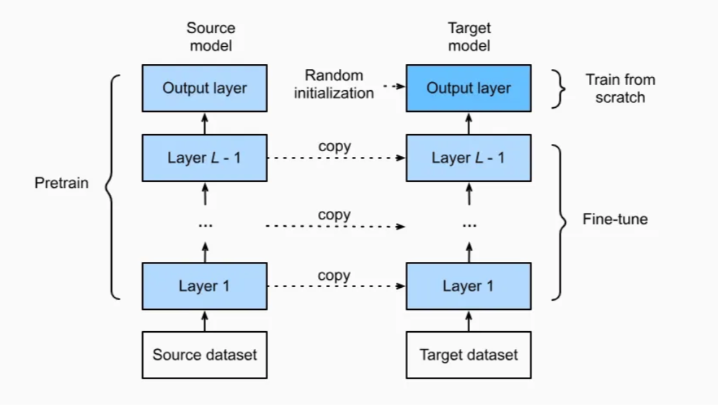

Slide 25
The Smart Strategy
The best practical approach is:
1. Start with Feature Extraction
Test the pretrained model as a baseline
Evaluate performance on the validation set
2. If Performance Isn’t Sufficient
Move to gradual fine-tuning
Start by unfreezing only the last layers
Gradually increase the number of unfrozen layers
3. Monitor Results
Track loss and accuracy on both train and validation sets
Watch out for overfitting

Slide 26
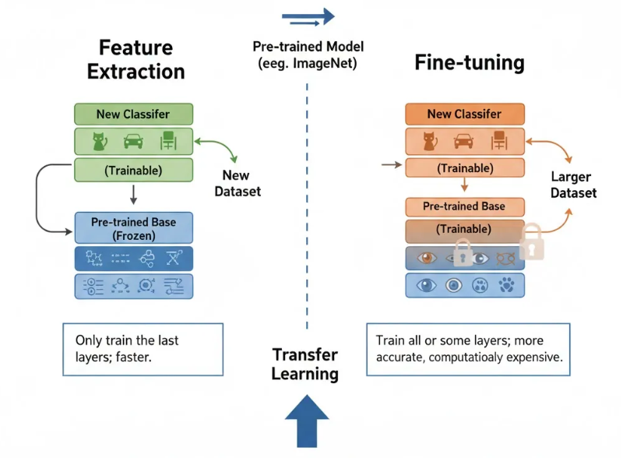

Slide 27
Steps for fine tuning
Select a Pre-trained Model: Choose a pre-trained model
Understand Model Architecture: Study the architecture of the pre-trained model, including the number of layers, their functionalities, and the specific tasks they were trained on.
Determine Fine-tuning Layers: Decide which layers of the pre-trained model to fine-tune. Typically, earlier layers capture low-level features, while later layers capture more high-level features. You may choose to fine-tune only the top layers or some of the entire model.
Freeze Pre-trained Layers: Freeze the weights of the pre-trained layers that you do not want to fine-tune. This ensures that you prevent these layers from being updated during training.
Add Task-specific Layers: Add new layers on top of the pre-trained model to adapt it to your specific task. These layers referred to as the “classifier,” will be responsible for making predictions relevant to your task.
Configure Training Parameters: Set the hyperparameters for training, including the learning rate(Small learning rate), batch size, and number of epochs. These parameters may need to be adjusted based on the size of your dataset and the complexity of your task.
Train the Model: Train the model on your dataset using a suitable optimization algorithm, such as stochastic gradient descent (SGD) or Adam. During training, the weights of the unfrozen layers will be updated to minimize the loss between the predicted outputs and the ground truth labels.

Slide 28
Fine Tuning

Slide 29
import numpy as np import tensorflow as tf from tensorflow.keras.applications import VGG16 from tensorflow.keras.datasets import cifar10 from tensorflow.keras.utils import to_categorical from tensorflow.keras.models import Sequential from tensorflow.keras.layers import Dense, Flatten # Load CIFAR-10 dataset (train_images, train_labels), (test_images, test_labels) = cifar10.load_data()

Slide 30
# Normalize pixel values to be between 0 and 1 train_images, test_images = train_images / 255.0, test_images / 255.0 # One-hot encode the labels train_labels = to_categorical(train_labels, num_classes=10) test_labels = to_categorical(test_labels, num_classes=10) # Load pre-trained VGG16 model without the top (classification) layer base_model = VGG16(weights='imagenet', include_top=False, input_shape=(32, 32, 3))

Slide 31
# Freeze the first few layers for layer in base_model.layers[:-4]: layer.trainable = False # Create a new model on top of the pre-trained base model model = Sequential([ base_model, Flatten(), Dense(256, activation='relu'), Dense(10, activation='softmax') # Output layer with 10 classes ])

Slide 32
# Compile the model model.compile(optimizer=tf.keras.optimizers.Adam(learning_rate=1e-4), loss='categorical_crossentropy', metrics=['accuracy']) # Train the model history = model.fit(train_images, train_labels, epochs=10, batch_size=64, validation_data=(test_images, test_labels)) # Evaluate the model test_loss, test_acc = model.evaluate(test_images, test_labels) print("Test Accuracy:", test_acc)

Slide 33
https://medium.com/munchy-bytes/transfer-learning-and-fine-tuning-363b3f33655d

Slide 34

Thank You

